Slide 1

Chapter 11, Testing

Slide 2
Testing – the problem
  Testing is the process of finding differences between the expected behavior specified by system models and the observed behavior of the implemented system.
  Unit testing finds differences between a specification of an object and its realization as a component.
  Structural testing finds differences between the system design model and a subset of integrated subsystems.
  Functional testing finds differences between the use case model and the system.
Notes:
Outline anpassen

Slide 3
Testing – the problem_2
  Performance testing finds differences between nonfunctional requirements and actual system performance.
  When differences are found, developers identify the defect causing the observed failure and modify the system to correct it. In other cases, the system model is identified as the cause of the difference, and the system model is updated to reflect the system.
  The goal of testing is to design tests that exercise defects in the system and to reveal problems. This activity is contrary to all other activities which are constructive activities.
Notes:
Outline anpassen

Slide 4
Testing – the problem_3
Unfortunately, it is impossible to completely test a nontrivial system.
First, testing is not decidable.
Second, testing must be performed under time and budget constraints.
As a result, systems are often deployed without being completely tested, leading to faults discovered by end users.
Notes:
Outline anpassen

Slide 5


Famous Problems
F-16 : crossing equator using autopilot
  Result: plane flipped over
  Reason?
    Reuse of autopilot
    software
The Therac-25 accidents (1985-1987), quite possibly the most serious non-military computer-related failure ever in terms of human life (at least five died)
  Reason: Bad event handling in the GUI
NASA Mars Climate Orbiter destroyed due to incorrect orbit insertion (September 23, 1999)
  Reason: Unit conversion problem.

Slide 6
Testing – perception
Testing is often viewed as a job that can be done by beginners.
Managers would assign the new members to the testing team, because the experienced people detested testing or are needed for the more important jobs of analysis and design.
Unfortunately, such an attitude leads to many problems.
A tester must have a detailed understanding of the whole system, ranging from the requirements to system design decisions and implementation issues.
A tester must also be knowledgeable of testing techniques and apply these techniques effectively and efficiently to meet time, budget, and quality constraints.
Notes:
Outline anpassen

Slide 7
Testing – overview
Reliability is a measure of success with which the observed behavior of a system conforms to the specification of its behavior.
Software reliability is the probability that a software system will not cause system failure for a specified time under specified conditions [IEEE Std. 982.2- 1988].
Failure is any deviation of the observed behavior from the specified behavior.
An erroneous state/error means the system is in a state such that further processing by the system will lead to a failure, which then causes the system to deviate from its intended behavior.
Notes:
Outline anpassen

Slide 8
Testing – overview_2
A fault/defect/bug, is the mechanical or algorithmic cause of an erroneous state.
The goal of testing is to maximize the number of discovered faults, which then allows developers to correct them and increase the reliability of the system.
We define testing as the systematic attempt to find faults in a planned way in the implemented software.
Contrast this definition with another common one: “testing is the process of demonstrating that faults are not present.”
Notes:
Outline anpassen

Slide 9
Testing activities
Test planning allocates resources and schedules the testing.
This activity should occur early in the development phase so that sufficient time and skill is dedicated to testing. Developers can design test cases as soon as the models they validate become stable.
• Usability testing tries to find faults in the user interface design of the system. Often, systems fail to accomplish their intended purpose simply because their users are confused by the user interface and unwillingly introduce erroneous data.
• Unit testing tries to find faults in participating objects and/or subsystems with respect to the use cases from the use case model.
Notes:
Outline anpassen

Slide 10
Testing activities_2
Integration testing is the activity of finding faults by testing individual components in combination. Structural testing is the culmination of integration testing involving all components of the system. Integration tests and structural tests exploit knowledge from the SDD (System Design Document) using an integration strategy described in the Test Plan (TP).
System testing tests all the components together, seen as a single system to identify faults with respect to the scenarios from the problem statement and the requirements and design goals identified in the analysis and system design, respectively:
Notes:
Outline anpassen

Slide 11
Testing activities_3
  Functional testing tests the requirements from the RAD and the user manual.
  Performance testing checks the nonfunctional requirements and additional design goals from the SDD. Functional and performance testing are done by developers.
  Acceptance testing and installation testing check the system against the project agreement and is done by the client, if necessary, with help by the developers.
Notes:
Outline anpassen

Slide 12
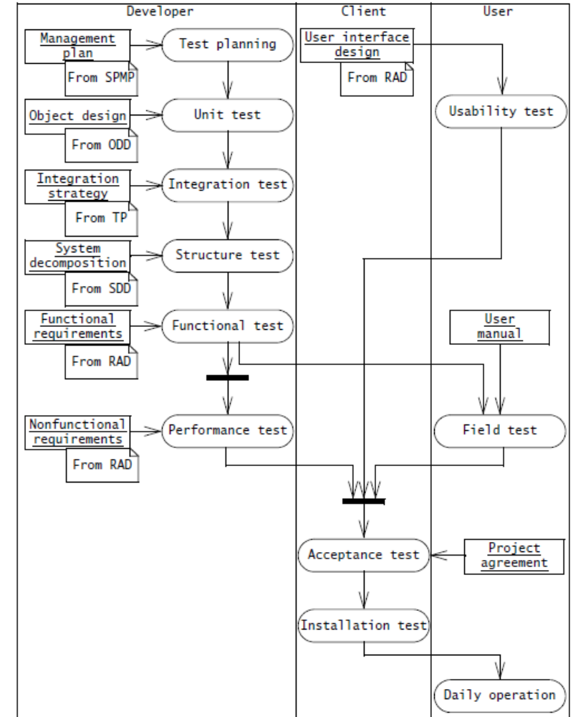
Testing activities and assoc. stakeholders
SPMP - Software Project Management Plan
TP - Test Plan
SDD - System Design Document
RAD - Requirements Analysis Document

Slide 13
Testing concepts
Test component is a part of the system that can be isolated for testing. A component can be an object, a group of objects, or one or more subsystems.
A fault/bug/defect, is a design or coding mistake that may cause abnormal component behavior.
An erroneous state is a manifestation of a fault during the execution of the system. An erroneous state is caused by one or more faults and can lead to a failure.
A failure is a deviation between the specification and the actual behavior. A failure is triggered by one or more erroneous states. Not all erroneous states trigger a failure.

Slide 14
Testing concepts_2
A test case is a set of inputs and expected results that exercises a test component with the purpose of causing failures and detecting faults.
A test stub is a partial implementation of components on which the tested component depends.
A test driver is a partial implementation of a component that depends on the test component. Test stubs and drivers enable components to be isolated from the rest of the system for testing.
A correction is a change to a component. The purpose of a correction is to repair a fault. Note that a correction can introduce new faults.

Slide 15
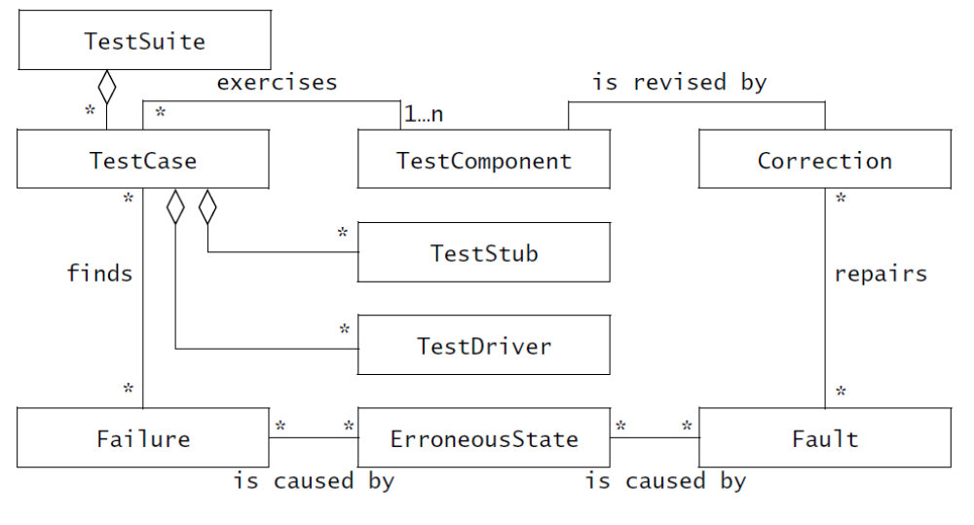
Model elements used during testing

Slide 16
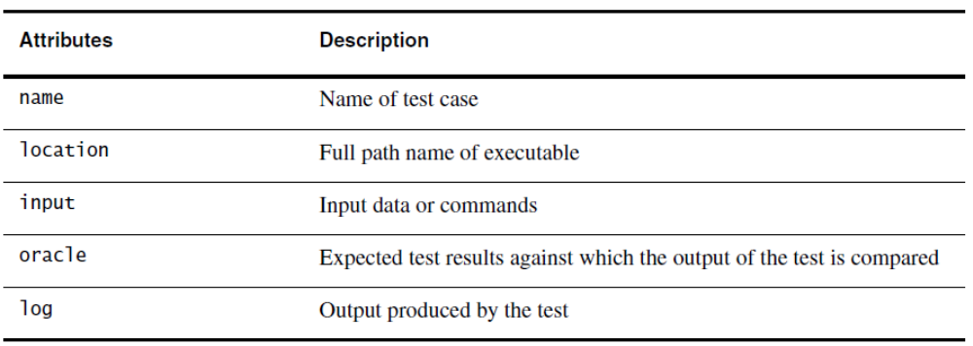
Attributes of the class TestCase
A test case is a set of input data and expected results that exercises a component with the purpose of causing failures and detecting faults. A test case has five attributes: name, location, input, oracle, and log

Slide 17
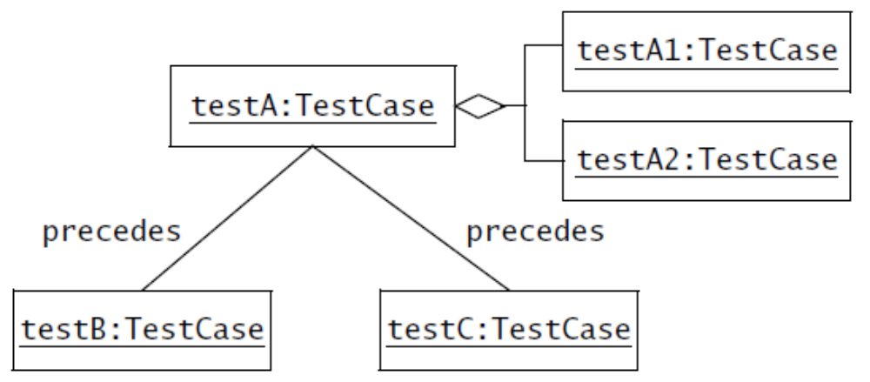
Test model width test cases
Once test cases are identified and described, relationships among test cases are identified.
Aggregation and the precede associations are used to describe the relationships between the test cases. Aggregation is used when a test case can be decomposed into a set of subtests. Two test cases are related via the precede association when one test case must precede another test case.

Slide 18
Test model width test cases
Test cases are classified into blackbox tests and whitebox tests:
Blackbox tests focus on the input/output behavior of the component. Blackbox tests do not deal with the internal aspects of the component, nor with the behavior or the structure of the components.
Whitebox tests focus on the internal structure of the component. A whitebox test makes sure that, independently from the particular input/output behavior, every state in the dynamic model of the object and every interaction among the objects is tested.

Slide 19
Test model width test cases_2
As a result, whitebox testing goes beyond blackbox testing. In fact, most of the whitebox tests require input data that could not be derived from a description of the functional requirements alone.
Unit testing combines both testing techniques: blackbox testing to test the functionality of the component, and whitebox testing to test structural and dynamic aspects of the component.
Executing test cases on single components or combinations of components requires the tested component to be isolated from the rest of the system. Test drivers and test stubs are used to substitute for missing parts of the system.

Slide 20
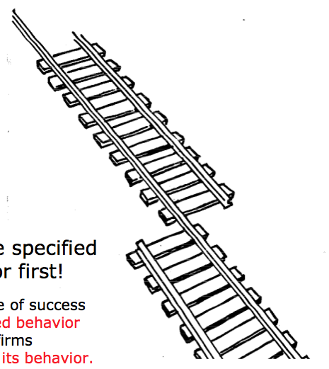
What is this?
A failure?
An error?
A fault?
We need to describe specified
and desired behavior first!

Slide 21
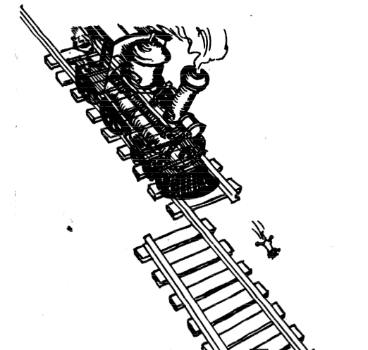
Erroneous State (“Error”)
An erroneous state is a manifestation of a fault during the execution of the system. An erroneous state is caused by one or more faults and can lead to a failure.

Slide 22
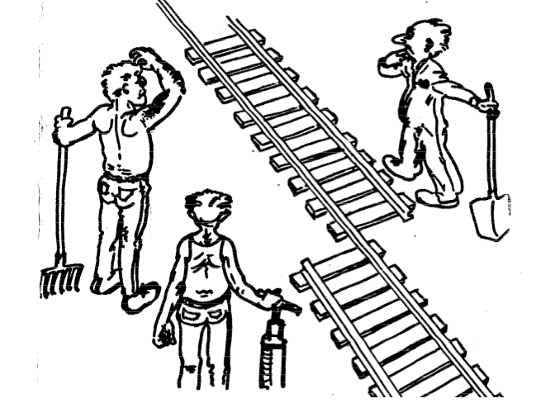
Algorithmic Fault

Slide 23

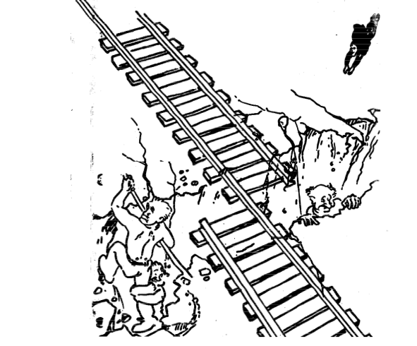
Mechanical Fault
A fault can have a mechanical cause, such as an earthquake

Slide 24

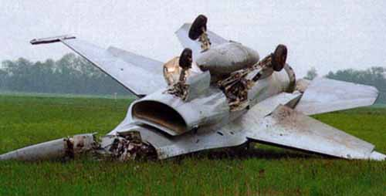
F-16 Bug
What is the failure?
What is the error?
What is the fault?
  Bad use of implementation
  inheritance
  A Plane is not a rocket.
Rocket
Plane

Slide 25
Examples of Faults and Errors
Faults in the Interface specification
  Mismatch between what the client needs and what the server offers
  Mismatch between requirements and implementation
Algorithmic Faults
  Missing initialization
  Incorrect branching condition
  Missing test for null
Mechanical Faults (very hard to find)
  Operating temperature outside of equipment specification
Errors
  Null reference errors
  Concurrency errors
  Exceptions.
Notes:
Beispiel Itunes
Jeder freier song

Slide 26
How do we deal with Errors, Failures and Faults?

Slide 27
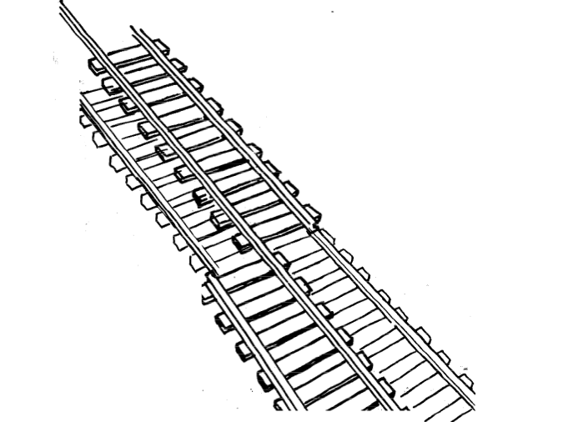
Modular Redundancy
The Saturn rocket that launched the Apollo spacecraft used triple modular redundancy for the guidance system; that is, each of the components in the computer was tripled. The failure of a single component was detected when it produced a different output than the other two.

Slide 28
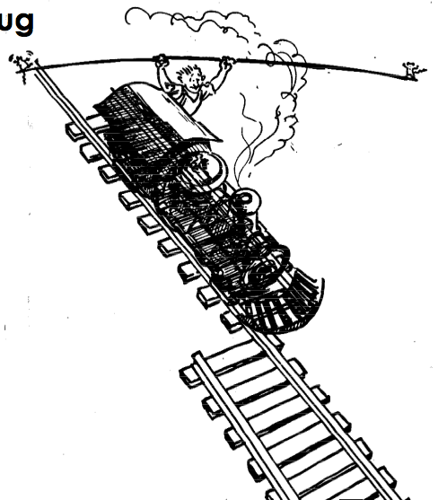
Declaring the Bug as a Feature

Slide 29
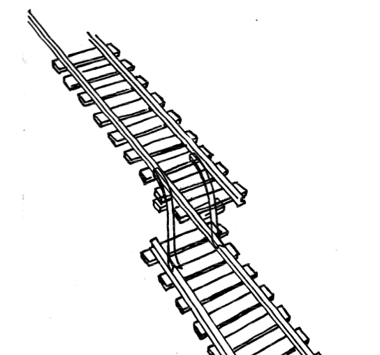
Patching
A patch is a set of changes to a computer program or its supporting data designed to update, fix, or improve it. This includes fixing security vulnerabilities and other bugs, with such patches usually being called bugfixes or bug fixes, and improving the usability or performance.

Slide 30
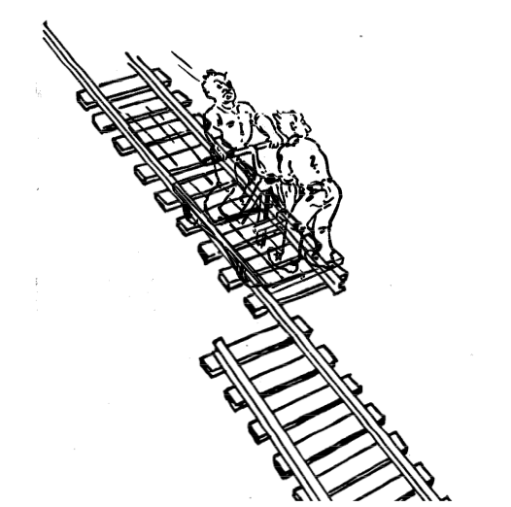
Testing

Slide 31
Another View on How to Deal with Faults
Fault avoidance (before the system release)
  Use methodology to reduce complexity
  Use configuration management to prevent inconsistency
  Apply verification to prevent algorithmic faults
  Use Reviews
Fault detection (while system is running)
  Testing: Activity to provoke failures in a planned way
  Debugging: Find and remove the cause (Faults) of an observed failure
  Monitoring: Deliver information about state => Used during debugging
Fault tolerance (recover from failure after release)
  Exception handling
  Modular redundancy.
Notes:
Fault avoidance (before the system is released):
Use programming methodology to reduce complexity
Use configuration management to prevent inconsistency
Apply verification to prevent algorithmic faults
Reviews
Fault detection (while system is running):
Testing: Create failures in a planned way
Debugging: Start with an unplanned failures
Monitoring: Deliver information about state. Find performance bugs
Fault tolerance (recover from failure once the system is released):
Atomic transactions (database systems)
Modular redundancy

Slide 32
Taxonomy for Fault Handling Techniques
Fault Handling
Fault
Avoidance
Fault
Detection
Fault
Tolerance
Methodoloy
Configuration
Management
Atomic
Transactions
Modular
Redundancy
Verification
Testing
Debugging
Unit
Testing
Integration
Testing
System
Testing
Notes:
Richtig machen

Slide 33
Observations
It is impossible to completely test any nontrivial module or system
  Practical limitations: Complete testing is prohibitive in time and cost
  Theoretical limitations: e.g. Halting problem
“Testing can only show the presence of bugs, not their absence” (Dijkstra).
Testing is not for free
=> Define your goals and priorities

Slide 34
Testing takes creativity
To develop an effective test, one must have:
  Detailed understanding of the system
  Application and solution domain knowledge
  Knowledge of the testing techniques
  Skill to apply these techniques
Testing is done best by independent testers
  We often develop a certain mental attitude that the program should in a certain way when in fact it does not
  Programmers often stick to the data set that makes the program work
  A program often does not work when tried by somebody else.
behave
Notes:
Testing often viewed as dirty work.
To develop an effective test, one must have:
Detailed understanding of the system
Knowledge of the testing techniques
Skill to apply these techniques in an effective and efficient manner
Testing is done best by independent testers
We often develop a certain mental attitude that the program should in a certain way when in fact it does not.
Programmer often stick to the data set that makes the program work
"Don’t mess up my code!"
A program often does not work when tried by somebody else.
"Every new user uncovers a new class of bugs”

Slide 35
Testing Activities
Unit
Testing
Integration
Testing
System
Testing
Acceptance
Testing
Object
Design
Document
System
Design
Document
Requirements
Analysis
Document
Client
Expectation
Unit
Testing
Integration
Testing
System
Testing
Acceptance
Testing
Developer
Client

Slide 36
Types of Testing
Unit
Testing
Integration
Testing
System
Testing
Acceptance
Testing
Unit Testing
  Individual component (class or subsystem)
  Carried out by developers
  Goal: Confirm that the component or subsystem is correctly coded and carries out the intended functionality
Integration Testing
  Groups of subsystems (collection of subsystems) and eventually the entire system
  Carried out by developers
  Goal: Test the interfaces among the subsystems.

Slide 37
Types of Testing continued...
Unit
Testing
Integration
Testing
System
Testing
Acceptance
Testing
System Testing
  The entire system
  Carried out by developers
  Goal: Determine if the system meets the requirements (functional and nonfunctional)
Acceptance Testing
  Evaluates the system delivered by developers
  Carried out by the client. May involve executing typical transactions on site on a trial basis
  Goal: Demonstrate that the system meets the requirements and is ready to use.

Slide 38
When should you write a test?
Traditionally after the source code is written
In XP before the source code written
  Test-Driven Development Cycle
    Add a test
    Run the automated tests
      => see the new one fail
    Write some code
    Run the automated tests
  => see them succeed
    Refactor code.

Slide 39
Unit Testing
Unit
Testing
Integration
Testing
System
Testing
Acceptance
Testing
Static Testing (at compile time)
  Static Analysis
  Review
    Walk-through (informal)
    Code inspection (formal)
Dynamic Testing (at run time)
  Black-box testing
  White-box testing.
Notes:
Static Analysis:
Manual execution: Reading the source code
Walk-through (informal presentation to others)
Code inspection (formal presentation to others)
Automated tools checking for
syntactic and semantic errors
departure from coding standards
Dynamic Analysis:
Black-box testing
White-box testing
Data-structure based testing
Black-box testing (Test the input/output behavior)
White-box testing (Test the internal logic of the subsystem or object)
Data-structure based testing (Data types determine test cases)

Slide 40




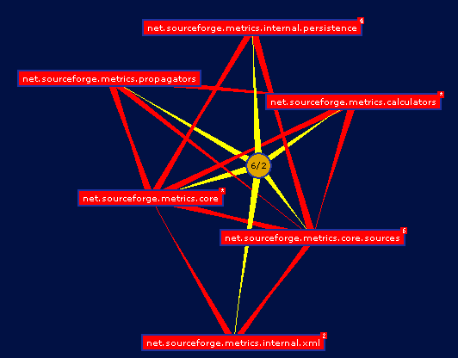
Static Analysis with Eclipse
Unit
Testing
Integration
Testing
System
Testing
Acceptance
Testing
Compiler Warnings and Errors
  Possibly uninitialized Variable
  Undocumented empty block
  Assignment has no effect
Checkstyle
  Check for code guideline violations
  http://checkstyle.sourceforge.net
FindBugs
  Check for code anomalies
  http://findbugs.sourceforge.net
Metrics
  Check for structural anomalies
  http://metrics.sourceforge.net

Slide 41
Black-box testing
Unit
Testing
Integration
Testing
System
Testing
Acceptance
Testing
Focus: I/O behavior
  If for any given input, we can predict the output, then the component passes the test
  Requires test oracle
Goal: Reduce number of test cases by equivalence partitioning:
  Divide input conditions into equivalence classes
  Choose test cases for each equivalence class.
Notes:
Focus: I/O behavior. If for any given input, we can predict the output, then the module passes the test.
Almost always impossible to generate all possible inputs ("test cases")
Goal: Reduce number of test cases by equivalence partitioning:
Divide input conditions into equivalence classes
Choose test cases for each equivalence class. (Example: If an object is supposed to accept a negative number, testing one negative number is enough)

Slide 42
Black-box testing: Test case selection
a) Input is valid across range of values
  Developer selects test cases from 3 equivalence classes:
    Below the range
    Within the range
    Above the range
b) Input is only valid, if it is a member of a discrete set
  Developer selects test cases from 2 equivalence classes:
    Valid discrete values
    Invalid discrete values
No rules, only guidelines.
Notes:
Rauslassen?

Slide 43
Black box testing: An example
public class MyCalendar {
public int getNumDaysInMonth(int month, int year)
throws InvalidMonthException
{ … }
}
Representation for month:
  1: January, 2: February, …., 12: December
Representation for year:
  1904, … 1999, 2000,…, 2006, …
How many test cases do we need for the black box testing of getNumDaysInMonth()?
Notes:
Depends on calendar: gregorian calendar
Month parameter equivalence classes
30 days
31 days
February
No month 0, 13, -1
year: parameter equivalence classes
Normal year
Leap year:
/4
/100
/400
Before christ/ After Christ year -200
Before at and after 2000
=> 12 test cases

Slide 44
White-box testing overview
Unit
Testing
Integration
Testing
System
Testing
Acceptance
Testing
Code coverage
Branch coverage
Condition coverage
Path coverage
=> Details in the exercise session about testing

Slide 45
Unit Testing Heuristics
1. Create unit tests when object design is completed
  Black-box test: Test the functional model
  White-box test: Test the dynamic model
2. Develop the test cases
  Goal: Find effective
  number of test cases
3. Cross-check the test cases to eliminate duplicates
  Don't waste your time!
4. Double check your source code
  Sometimes reduces testing time
5. Create a test harness
  Test drivers and test stubs are needed for integration testing
6. Describe the test oracle
  Often the result of the first successfully executed test
7. Execute the test cases
  Re-execute test whenever a change is made (“regression testing”)
8. Compare the results of the test with the test oracle
  Automate this if possible.
Notes:
Develop the test cases
Goal: Find minimal num-
ber of test cases to cover as many paths as possible
Don’t forget regression testing
Re-execute test cases every time a change is made.

Slide 46
JUnit: Overview
Unit
Testing
Integration
Testing
System
Testing
Acceptance
Testing
A Java framework for writing and running unit tests
  Test cases and fixtures
  Test suites
  Test runner
A test fixture (also known as a test context) is the set of preconditions or state needed to run a test. The developer should set up a known good state before the tests, and return to the original state after the tests
Written by Kent Beck and Erich Gamma

Slide 47
JUnit: Overview_2
Unit
Testing
Integration
Testing
System
Testing
Acceptance
Testing
Written with “test first” and pattern-based development in mind
  Tests written before code
  Allows for regression testing
  Facilitates refactoring
JUnit is Open Source
  https://junit.org/junit5/
  JUnit Version 5, was released on OCT 24, 2017

Slide 48
JUnit Classes
*
TestResult
Test
run(TestResult)
TestCase
TestSuite
testName:String
run(TestResult)
run(TestResult)
addTest()
setUp()
tearDown()
runTest()
ConcreteTestCase
UnitToBeTested
Methods under Test
setUp()
tearDown()
runTest()

Slide 49
An example: Testing MyList
Unit to be tested
  MyList
Methods under test
  add()
  remove()
  contains()
  size()
Concrete Test case
  MyListTestCase

Slide 50
*
TestResult
Test
run(TestResult)
TestCase
TestSuite
testName:String
run(TestResult)
run(TestResult)
addTest()
setUp()
tearDown()
runTest()
MyListTestCase
MyList
setUp()
tearDown()
runTest()
testAdd()
testRemove()
add()
remove()
contains()
size()

Slide 51
Writing TestCases in JUnit
public class MyListTestCase extends TestCase {
public MyListTestCase(String name) {
super(name);
}
public void testAdd() {
// Set up the test
List aList = new MyList();
String anElement = “a string”;
// Perform the test
aList.add(anElement);
// Check if test succeeded
assertTrue(aList.size() == 1);
assertTrue(aList.contains(anElement));
}
protected void runTest() {
testAdd();
}
}
*
TestResult
Test
run(TestResult)
TestCase
TestSuite
testName:String
run(TestResult)
run(TestResult)
addTest()
setUp()
tearDown()
runTest()
MyListTestCase
MyList
setUp()
tearDown()
runTest()
testAdd()
testRemove()
add()
remove()
contains()
size()

Slide 52
Writing Fixtures and Test Cases
public class MyListTestCase extends TestCase {
// …
private MyList aList;
private String anElement;
public void setUp() {
aList = new MyList();
anElement = “a string”;
}
public void testAdd() {
aList.add(anElement);
assertTrue(aList.size() == 1);
assertTrue(aList.contains(anElement));
}
public void testRemove() {
aList.add(anElement);
aList.remove(anElement);
assertTrue(aList.size() == 0);
assertFalse(aList.contains(anElement));
}
Test Fixture
Test Case
Test Case
Notes:
A test fixture is a set of instances and links that are used as a dummy environment for the test cases. By factoring out the initialization of the fixture into the setUp() method, fixtures can be reused between test cases. The tearDown() method is used to clean up after a test, so that the fixture can be rebuilt from scratch for the next test case. The white paper from which these concepts are taken can be found at:
http://junit.sourceforge.net/doc/cookbook/cookbook.htm

Slide 53
Collecting TestCases into TestSuites
public static Test suite() {
TestSuite suite = new TestSuite();
suite.addTest(new MyListTest(“testAdd”));
suite.addTest(new MyListTest(“testRemove”));
return suite;
}
*
Test
Composite Pattern!
run(TestResult)
TestCase
TestSuite
testName:String
run(TestResult)
run(TestResult)
addTest()
setUp()
tearDown()
runTest()

Slide 54
Design patterns in JUnit
*
TestResult
Test
Command Pattern
run(TestResult)
Composite
Pattern
TestCase
TestSuite
testName:String
run(TestResult)
Template Method
Pattern
run(TestResult)
addTest()
setUp()
tearDown()
runTest()
ConcreteTestCase
TestedUnit
Adapter
Pattern
setUp()
tearDown()
runTest()

Slide 55
Other JUnit features
Textual and GUI interface
  Displays status of tests
  Displays stack trace when tests fail
Integrated with Maven and Continuous Integration
  http://maven.apache.org
    Build and Release Management Tool
  All tests are run before release (regression tests)
  Test results are advertised as a project report
Many specialized variants
  Unit testing of web applications
  J2EE applications

Slide 56
Additional Readings
JUnit Website junit.org/junit5

